Slide 1
Introduction to Machine Learning
CS3300 Data Science
RJ Nowling

Slide 2
Readings
Chapter 7
Section 11.5

Slide 3
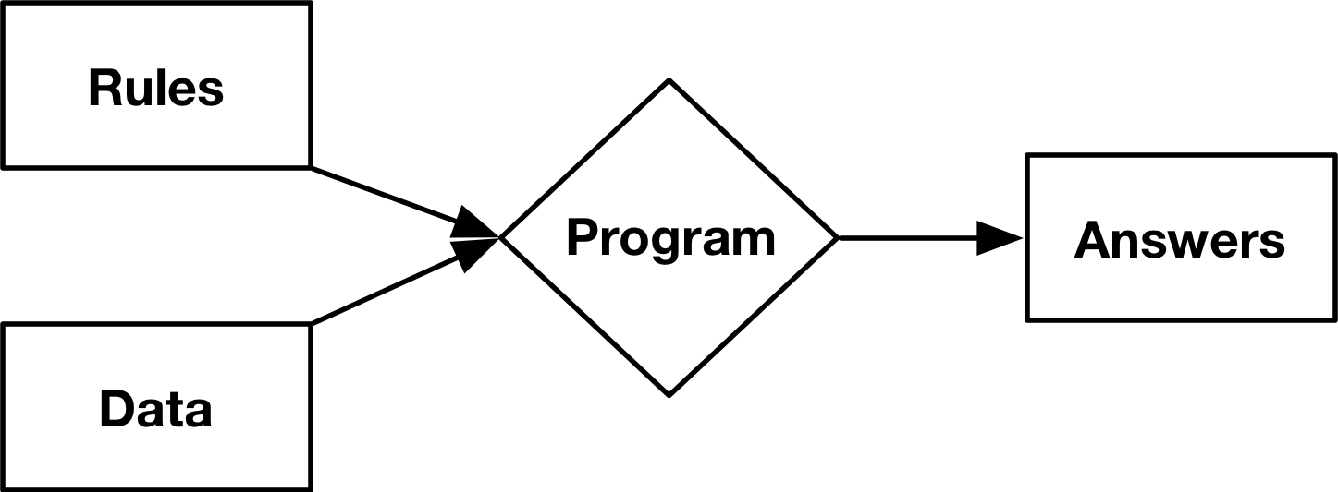
Traditional Programming

Slide 4
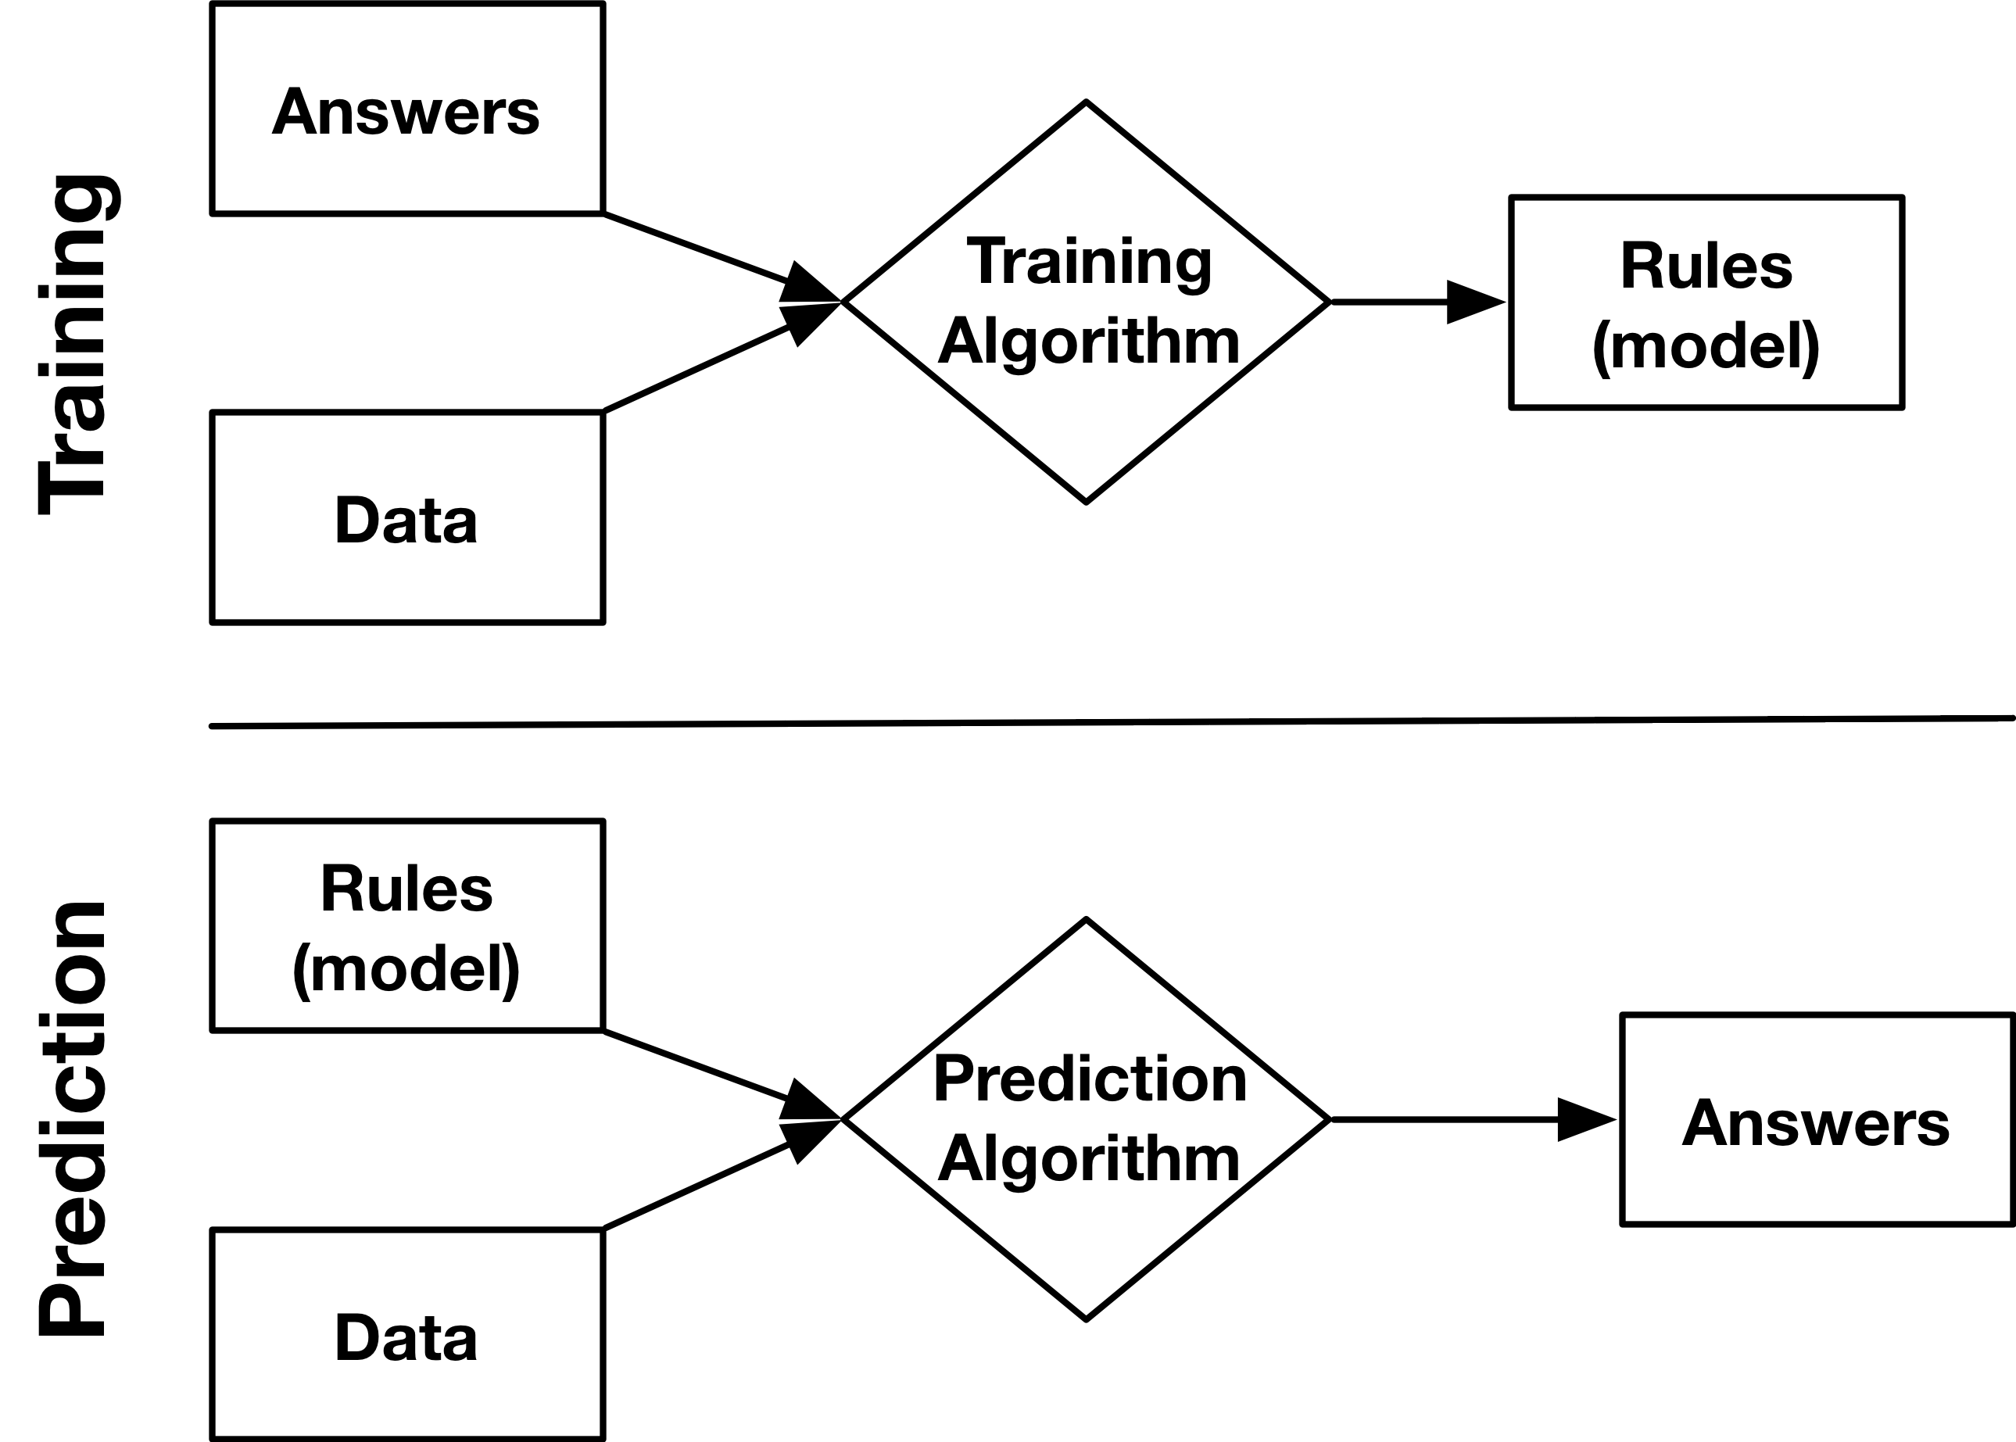
Machine Learning

Slide 5
Machine Learning
Goal: automated decision making
Is this a cat or a dog?
Reduce the time / cost to make decisions
More consistent decision making
More accurate decision making

Slide 6
Social Media
"Timelines" on Facebook, "What you missed" on Twitter
Filter, recommend "relevant" content – move away from purely chronological display
User engagement important to retention
Revenue depends on ad impressions
Can't show ads if users aren't on the platform
More usage -> collect more data -> show more relevant ads
Users leave when bored or frustrated
Need to quickly and continually connect users to engaging content

Slide 7
Copyright and SOPA
User-generated content: free, produced at massive scale
Stop Online Piracy Act (SOPA) – introduced 2011/2012
Would have made social media companies liable for copyright violations in user-generated content
Problematic: social media companies could be sued for enormous amounts of money even for small violations
Would have to hire people to review every new post, video, etc. – prohibitive due to cost and speed -> drive companies out of business
SOPA was prevented from becoming law

Slide 8
Copyright and SOPA
Companies now use "layered" process
Machine learning tags to tag copyright violations in new content
Reject content predicted to violate copyright; let other content pass
Humans receive and can process appeals from users and copyright violation notices from companies
Machine learning is less accurate but can make decisions quickly
Users can still post content almost immediately, while reviewers only see a small fraction of overall content
Reduce copyright infringement but in a sustainable way

Slide 9
Digital Advertising
Traditional print, TV, and radio advertising can only broadcast to a wide segment of customers
Digital adverting can be customized for each user
More direct feedback on effectiveness of advertising by tracking clicks and purchases
Machine learning is used in real time to:
Predict which companies you'll buy from
Which ads you'll click on

Slide 10
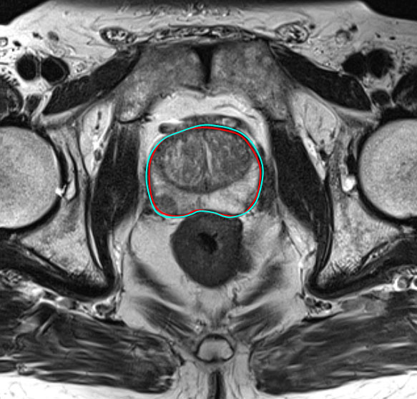
Biomedical Image Segmentation
Courtesy of Dr. Peter LaViolette's group
at the Medical College of Wisconsin

Slide 11
Books to Read
The Zap Gun by Philip K. Dick
Speculates about "perfect" weapons that can target a specific person and only that person.
Prediction Machines: The Simple Economics of Artificial Intelligence by Agrawal, Gans, and Goldfarb
Reframe key innovation of ML / AI as a "drop in the cost of prediction"
Increased productivity – new business models
Reduces uncertainty – enabling new business strategies

Slide 12
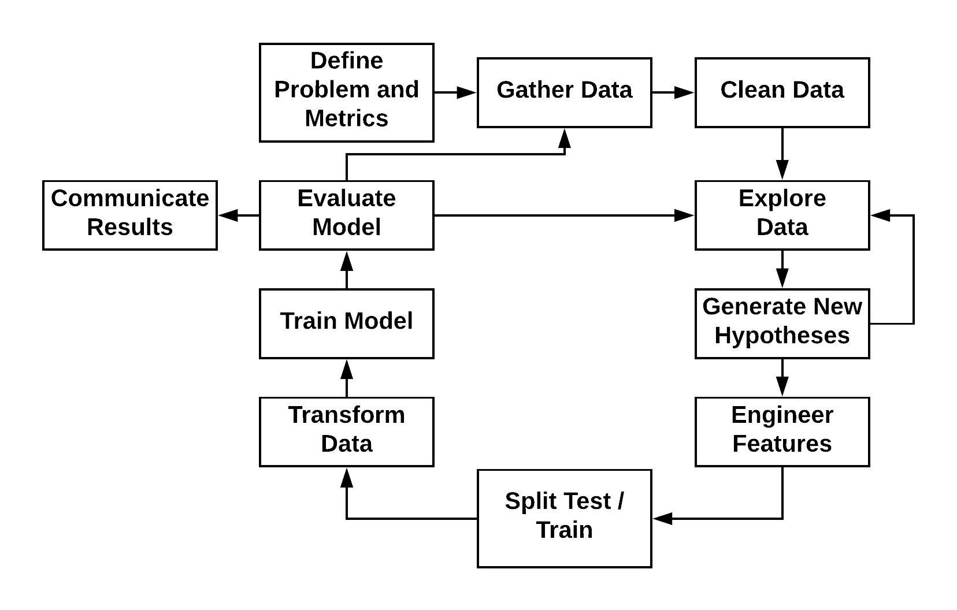
Machine Learning Process

Slide 13
Define a Problem
We want to predict the sale price for real estate transactions. Regression
We want to predict whether the animal in a picture is a cat or dog. Classification

Slide 14
A Good Problem Definition
Does
Does Not
Specific
Defines the variable to be predicted and its type
Optionally, describes the metric used to evaluate the predictions
List a specific machine learning algorithm

Slide 15
Feature Engineering
Dear Class, I've uploaded the new homework to D2L. It's due on Monday. I'm looking forward to seeing your solutions! RJ
?
[0, 1, 0, 0, 0, 1, 1, 0, 0]

Slide 16
Evaluation
We evaluate models by comparing predictions to known values
We use metrics to quantify the amount of error
The choice of metric depends on:
The type of machine learning problem (e.g., classification or regression)
Whether some types of errors are more important than others

Slide 17
Experimental Setup
We train machine learning models to make predictions about unseen data
To realistically evaluate a model, we need to design an experiment that accurately reflects how we intend to use the model

Slide 18
Supervised Machine Learning
Supervised
We are trying to predict the values of a variable
We train the model using samples with known values
We apply the model to samples for which the value is not known
Classification -- predict a categorical value
Does the picture contain a cat or a dog?
Regression -- predict a continuous value
How much money will the house sell for?

Slide 19
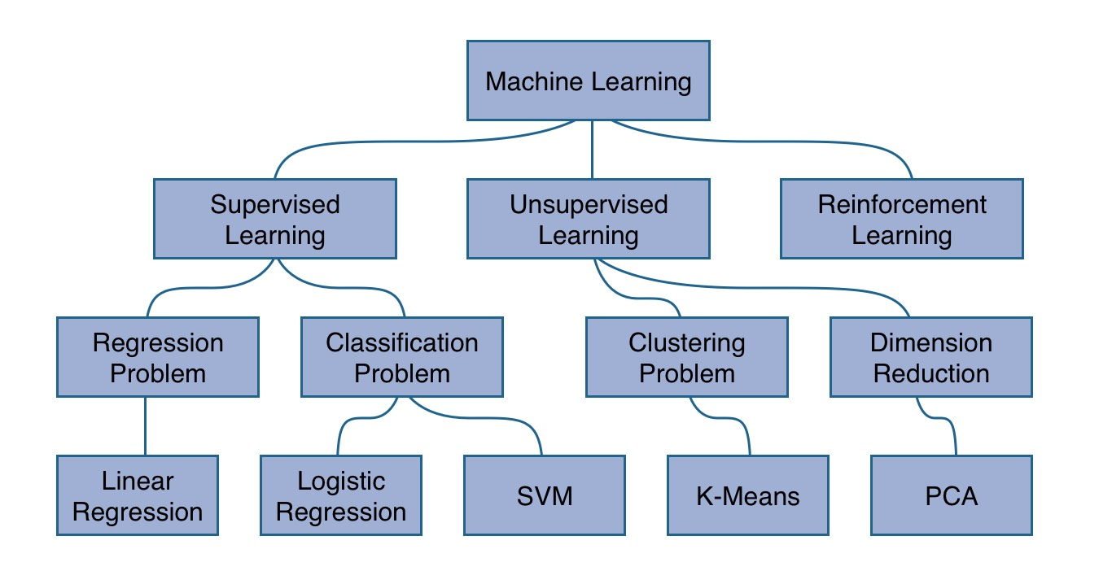
Machine Learning
https://www.robinwieruch.de/machine-learning-javascript-web-developers/

Slide 20
Common Regression Algorithms
Linear Regression
Polynomial Regression
Multivariate Adaptive Regression Splines (MARS)
k-Nearest Neighbors (kNN) Regression
Random Forest Regression
Neural Network Regression

Slide 21
Common Classification Algorithms
Logistic Regression
k-Nearest Neighbors (kNN)
Random Forests
Support Vector Machines (SVMs)
Naïve Bayes
Neural Networks

Slide 22
Unsupervised Machine Learning
Used when you have data that does not have an output variable
Often used in an exploratory setting to identify relationships between samples or patterns in the data
Common approaches include:
Clustering – grouping samples into a discrete set of clusters
Dimensionality Reduction – reducing the number of variables by grouping variables

Slide 23
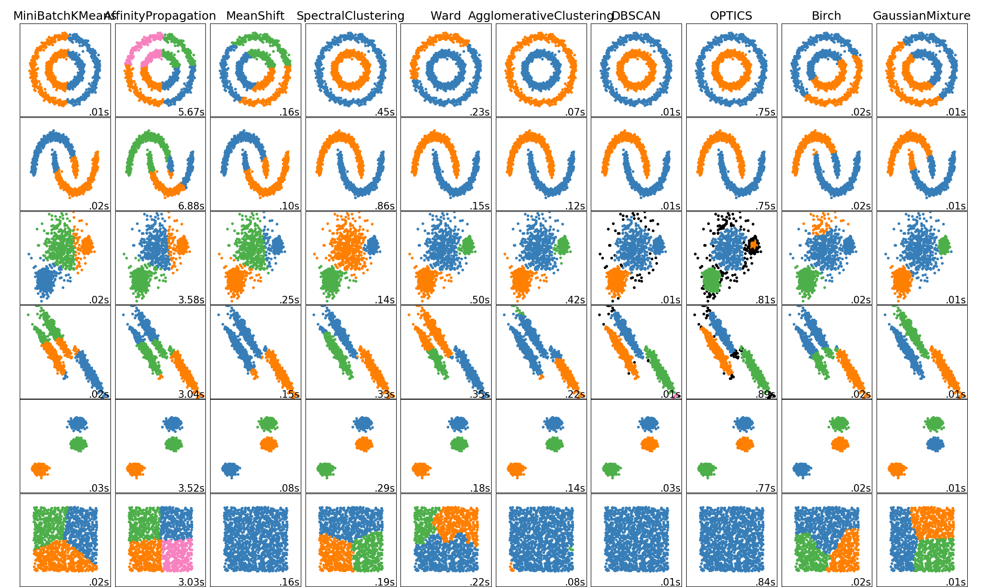
Clustering
https://scikit-learn.org/stable/modules/clustering.html

Slide 24
Common Clustering Algorithms
k-Means
k-Medoids
Ward's Hierarchical Clustering
Gaussian Mixture Models
DBSCAN
Spectral Clustering

Slide 25
Dimensionality Reduction
Principal Component Analysis (PCA)
Non-negative Matrix Factorization (NMF)
Uniform Manifold Approximation and Projection (UMAP)
Variational Autoencoder (VAEs)

Slide 26
Scikit-Learn
Popular Python library for machine learning
One of the most widely used for machine learning, period
Key innovations:
High quality software with regular releases
Includes a large array of algorithms – hard to find something missing!
Great user documentation
Fit nearly all models into a unified API
http://scikit-learn.org/stable/user_guide.html

Slide 27
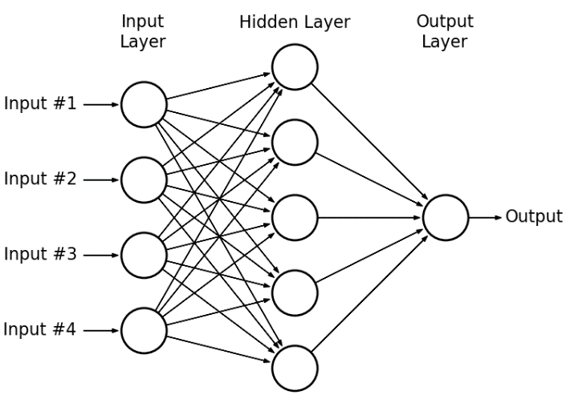
Artificial Neural Networks (ANNs)
Artificial neural networks consists of layers of neurons
Each layer usually has the same type of neurons
The outputs of the neurons in the previous layer are used as the inputs of the neurons in the next layer

Slide 28
Artificial Neural Networks (ANNs)
Invented in 1943 by Warren McCulloch and Walter Pitts
Inspired by neurons in animal brains

Slide 29
Artificial Neural Networks (ANNs)
Despite their long history, ANNs have only recently out-performed other machine learning models
In 2012, a convolutional neural network called AlexNet outperformed all competitions in the ImageNet competition
In 2011, a good classification error was 25%
AlexNet achieved an error rate of 16% -- a 10% improvement and significant step forward
By 2015, deep learning models were out performing humans
Deep learning models are ANNs with many layers

Slide 30
Artificial Neural Networks (ANNs)
Contributing factors that enabled deep learning:
Increase in available data – deep learning methods require a massive amount of data to avoid over-fitting
Increase in computational power – GPUs are well-suited to training deep learning models
Algorithm advances – small changes to the math solved the "vanishing gradient" problem which had previously prevented using more than one or two hidden layers
Easy-to-use, high-quality, and free software frameworks that run on commodity hardware

Slide 31
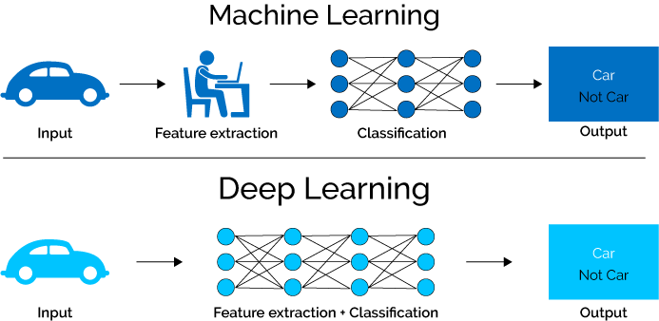
Deep Learning
https://www.upwork.com/hiring/for-clients/log-analytics-deep-learning-machine-learning/

Slide 32
What You'll Learn
Unsupervised learning for exploratory data analysis
Defining classification and regression problems
Experimental setup for training and evaluating models
Feature engineering and selection
Evaluation metrics
We will focus on applications rather then methods

Slide 33
What You Won't Learn
Details of machine learning algorithms
More than one example ML model per problem type
Deep learning techniques
Techniques for handling images, audio, and other complex data types
Good news! You'll learn this in the Machine Learning and Deep Learning courses

